Slide 1
SOEN 6441 Advanced Programming Practices Winter 2021
Team 11
Build 1

Slide 2
Architecture Used
Model View Controller (MVC)
A three-tier architectural model
Model: Manages the behavior and data of application domain
View: Renders the contents of a portion of model’s data.
Controller: Receives user input and initiates a response by making calls on appropriate model objects.

Slide 3
Coding Conventions
Naming Convention:
Class names in CamelCase that starts with capital letter.
Data member starts with d_
Method parameters starts with p_
Local variable starts with l_
Global variable in capital letters
Static members starts with capital letter, non static members starts with small case letters.

Slide 4
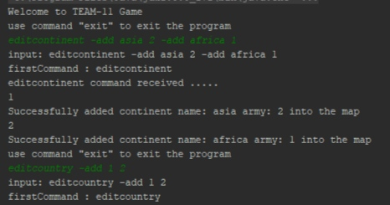
Functional Requirements:
This game includes a command prompt available throughout the game. All the commands are validated and give proper feedback on their effect or invalidity.

Slide 5
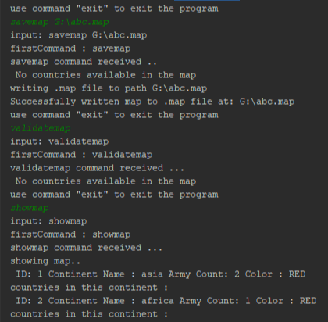
Commands for Map-Editor
editcontinent -add asia 2 -add america 3 -add africa 4
editcountry -add india asia -add china asia
editneighbor -add india china -add pak china
showmap
savemap d:\abc.map
editmap d:\abc.map
validatemap

Slide 6
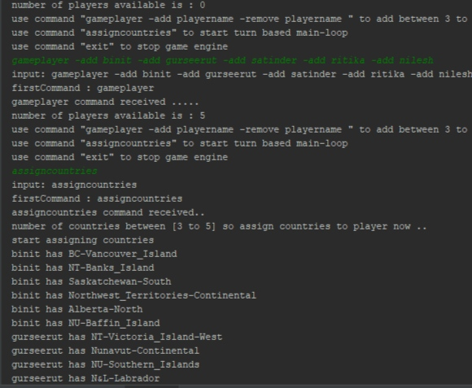
Commands for Game-Play
loadmap D:\maps\canada\canada.map
gameplayer -add binit -add gurseerut -add satinder -add ritika -add nilesh
assigncountries
showmap
deploy 1 1

Slide 7
Project includes
Functional Requirements
Map Editor
Game Play
Programming Process
Goal
To develop Risk Game using given Build 1 requirements.

Slide 8
Architecture Diagram

